Slide 1
Everton Shareholders’ association annual General Meeting
Goodison Park, Monday 21st August 2023

Slide 2
Agenda
Housekeeping (Fire exits)
Minutes silence in memory of Michael Jones
Approve Minutes of 2022 AGM
Receive and Consider Executive Committee Report of 2022/23
Overview of the last year from the committee
Receive and Approve the audited Balance Sheet and Statement of Accounts
Approve the Appointment of the Auditors
Approve the Annual Subscription
Elect the Executive Committee for the ensuing year
Any Other Business
Allocation of Tickets for the Directors’ Box

Slide 3
Executive Committee Report of 2022-23
Approve minutes of last AGM
Club meetings:
A single face-to-face meeting has taken place with the club in the past 12-months
September 2022 at the Royal Liver Building
Club colleagues in attendance:
Richard Kenyon
Scott McLeod
Aidan Miller
Since then, the Chair has been trying to get the club to commit to a regular schedule of Quarterly Meetings. The club have given tentative dates in late Sept and mid Dec for next meetings.
Notes:
Someone who has read the minutes and second them 28/29 Sep 2023 15.00-16.30
11 Dec 2023 15.00-16.30

Slide 4
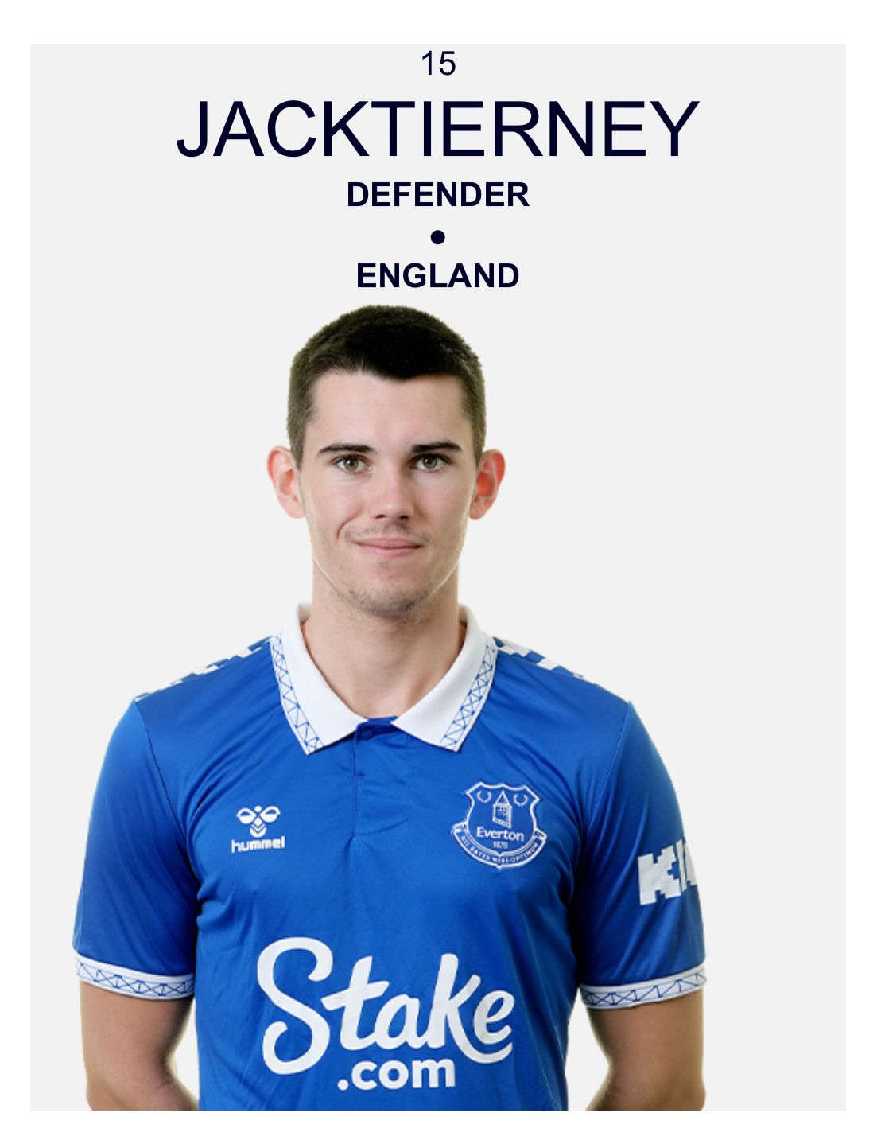
Executive Committee Report of 2022-23
Overview
The Association continues to maintain good media relations, specifically with the Liverpool ECHO, BBC Radio Merseyside, Radio City, Toffee TV and Sky Sports, and liaising with local and national journalists
EFCSA Awards
Tony Heslop Memorial Award Winner for 2023 is Jack Tierney
Jack has recently signed a 2-year professional contract

Slide 5
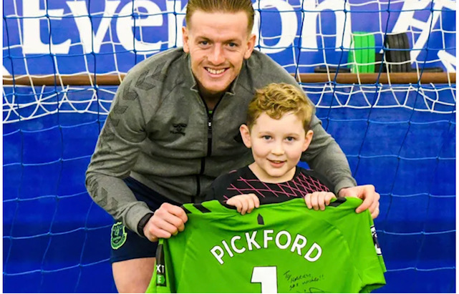
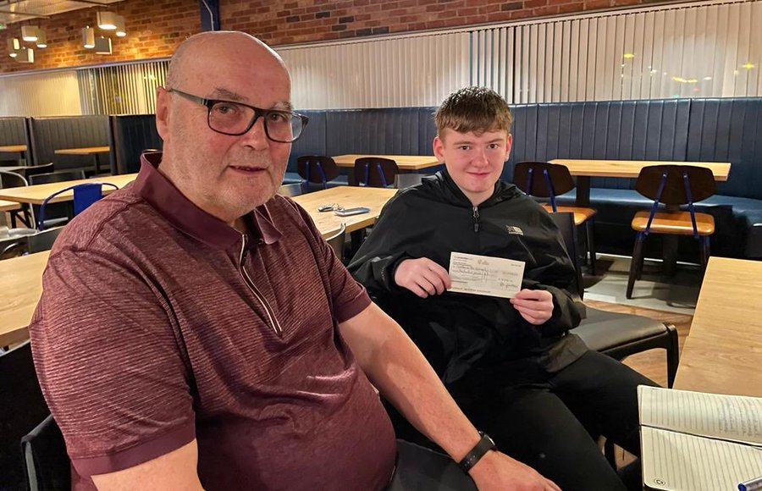
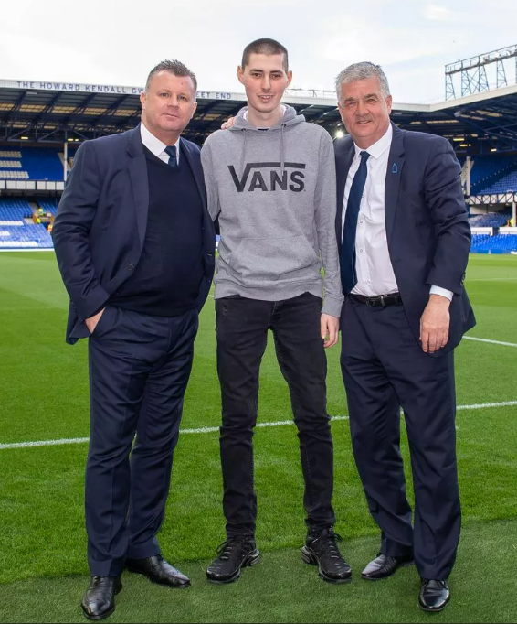
Executive Committee Report of 2022-23
Charity donations
The financial position of EFCSA has allowed donations of the below to be made to local charities during 2022/3
Alfie’s Squad £ 500
Harry Garside £ 500
Oliver Cooper £ 500
Total of £1,500 in year 2022/23
Ensuring our balance provision has been made for 2023-2024 to remain over £10,000

Slide 6
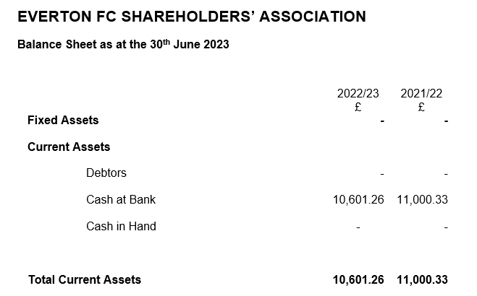
Financial Summary
Cash at bank has reduced to £10,601.26
Liabilities (donations) provisional total £3,000
Unlikely to utilise all, as we would like to keep £10k in reserves
Current Assets £7,601.26

Slide 7
Balance Sheet and Statement of Accounts
2022/23 Accounts
Reviewed by
Executive Committee Members, signed off by Ian Webster & Ian Seymour
Audited by
Andy Craven , FCMA, CGMA, Chartered Management Accountant

Slide 8
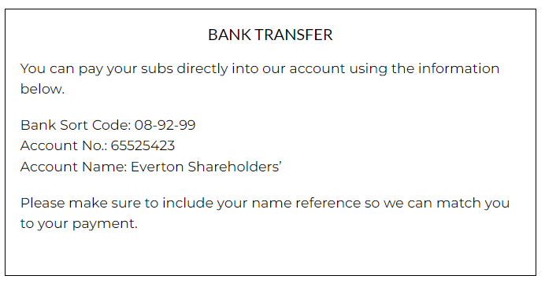
Appointment of the Auditors
The Executive Committee proposes that we appoint Andy Craven as our Auditor for the forthcoming year.
Approve the Annual Subscription
The Executive Committee recommends that the Annual Subscription becomes a £10 yearly renewal contribution for all members and also any new members wishing to join.
Pay direct via EFCSA.org website

Slide 9
Executive Committee Report of 2022-23
The Everton Stadium at Bramley Moore Dock
Last visit in Sept 2022.
We have approached the club for a further visit, but they have stated since the incident on site on Monday 14th August, all visits have been ceased
Share matching
EFCSA continues to help and support those wishing to sell or buys shares in EFC

Slide 10
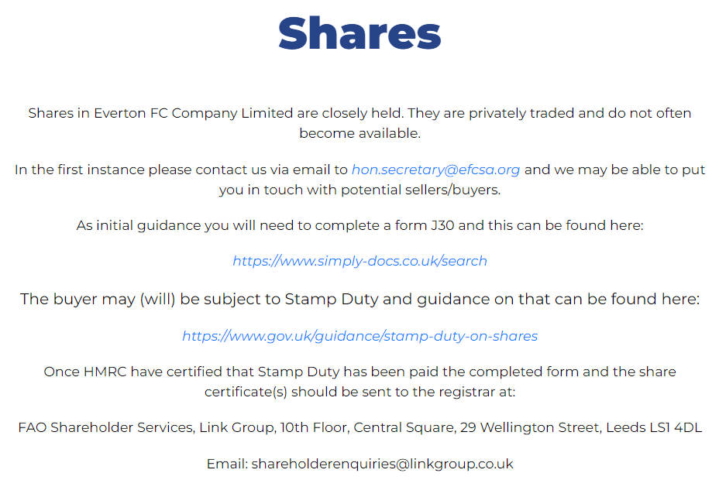
Share Trading
Matching of Buyers and Sellers for EFC Shares via contacting EFCSA
Notes:
Ian has an update – on Blankstone

Slide 11
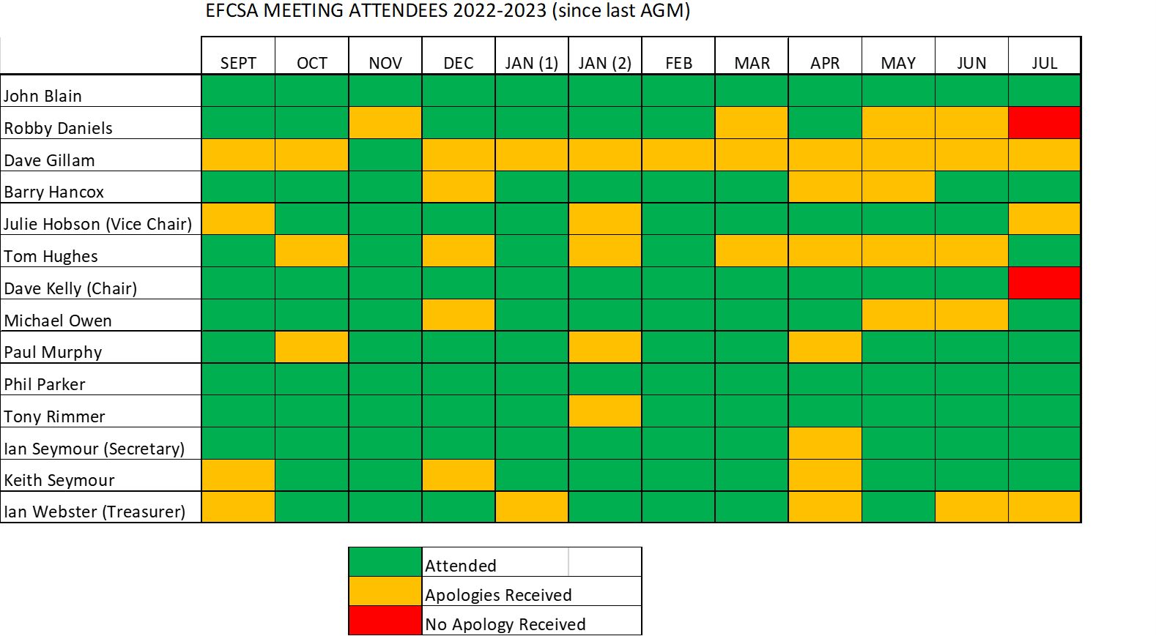
Attendance Record

Slide 12
Executive Committee for 2022/23 Candidates seeking Election
Paul Murphy
Phil Parker
Mike Owen
Keith Seymour
Ian Webster (Treasurer)
Anthony Rimmer
Ian Seymour (Hon Secretary)
John Blain
Dave Kelly (Chair)
Robbie Daniels
Julie Hobson (Vice-Chair)
Tom Hughes
Barry Hancox
*Martin Williams
Ian Seymour is standing down as Honorary Secretary after 10-years of service.
The Association would like to thank him for his commitment throughout this period
We also thank Dave Gillam for his contribution during his recent term on the committee

Slide 13
Any Other Business

Slide 14
Draw for Directors’ Box Tickets

Slide 15
Election of Committee Members

Slide 16
Everton Shareholders’ association annual General Meeting
Goodison Park, 21st August 2023

